Slide 1
Discharge Assistance Program (DAP)
Rate Study Implementation
Provider Information Session
Heather Rupe
Office of Patient Continuum Services

Slide 2
Background and Current Status
Discharge Assistance Program (DAP) has been a last resort funding source for state hospital discharges since 1998
Developed for those with extraordinary barriers to discharge from state facilities
Developed to meet one-time costs
Currently being used consistently as a funding source for residential services
85% of funds used in residential services
DAP pays provider determined rates for individuals needing Group home, ALF, and NH care.
This creates inconsistency in level of care provided and paid for

Slide 3
Why??
DAP funds are general state funds that are designed for moving individuals from state psychiatric institutions.
DAP is payor of last resort and require monitoring and utilization management to free up additional funds for more discharges.
To create consistency, predictability and sustainability DAP needs a model for identifying residential rates.
This assures that patients are receiving the services needs and providers are being paid for those services consistently across the state.

Slide 4
What is Staying the Same?
DAP continues to be avaliable to pay for residential level of care for individuals discharging from state facilities with barriers to discharge.
Providers continue to work directly with Community Service Board providers for placement, monitoring, and payment.
Patients still required to pay portion of costs from their funds.
DAP continues to be payor of last resort
Fall 2023

Slide 5
What is Changing?
DAP rate determined by client needs on Uniform Assessment Instrument
Rate per need determined by Berry Dunn Study https://rga.lis.virginia.gov/Published/2023/RD334
All DAP residential recipients will utilize the Public Pay UAI with behavioral assessment to determine rate
Rate cap in place depending on level of care needed
Rate system has built in rate increases (subject to available funding)
Customized rate process for requests above funding cap

Slide 6
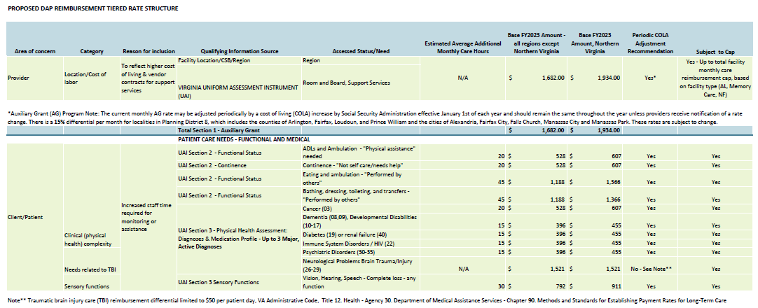
Rates

Slide 7
Rates

Slide 8
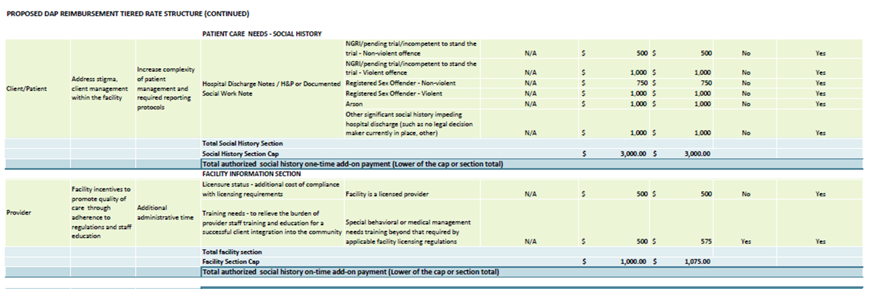
Rates

Slide 9
Implementation Timeline
October 2023
Three provider information sessions
FAQ document
November 2023
CSB training on rate tool
January 1, 2024
All new DAP plans utilize rate structure
This includes new discharges or any new change to an existing plan (e.g. move to new provider, etc.)
January 1, 2024 through June 30, 2024
All current DAP plans will be transitioned to new rate structure
March 2024
Updated UAI and Level of Care Training for CSBs and Hospitals

Slide 10
Questions
Provider Q&A

